Slide 1
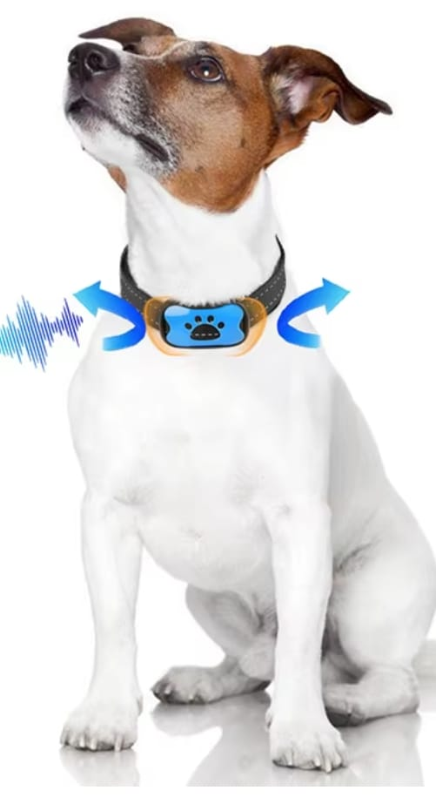

Snoretta
Pitch Deck 2025
By: Meet Your Teeth Dental Clinic

Slide 2
Dear reader,
Snoretta Oy is at the forefront of innovation, providing cutting-edge solutions in revolutionizing respiratory effort monitoring. Our background in the medical technology industry - particularly with our successful ventures at Nukute Oy - we have built a reputation for excellence and reliability. Now, we are excited to expand our expertise into the veterinary field, bringing you the same level of dedication and precision in monitoring respiratory effort in animals.
Over the past two years our dedicated multi-professional research team has collaborated closely with the esteemed University of Helsinki's Faculty of Veterinary Medicine Research Department. This invaluable partnership has allowed us to gain deep insights into the physiological parameters and unique challenges associated with monitoring respiratory effort in animals.
Our innovative and non-invasive technology guarantees highly accurate measurements, monitoring respiratory effort with precision and instantly granting access to the real-time respiratory effort data.
We stay up-to-date with the latest trends in biotelemetry, constantly refining and enhancing our systems to provide you with the most advanced and future-proof solutions. Invest in our state-of-the-art respiratory effort monitoring solution and gain a head start in the field.
Trust Snoretta to deliver exceptional results, backed by our unwavering commitment to excellence and our passion for improving animal health. Contact us today to learn more about how our innovative biotelemetric technology can transform the way you monitor respiratory effort in animals.
Discussion Framework
-
02

Slide 3


Groundbreaking Health Technology
Company
Snorettas sophisticated auscultation system integrated into mobile or tablets enabling precise and accurate measurement of respiratory effort.
This advanced technology opens the doors to a comprehensive panel of respiratory data, offering valuable insights into the animals breathing patterns, respiratory rates, apnea events and other crucial parameters.
But that's not all - our sensors also capture cardiac performance and circulatory information, further enhancing the scale of our biometric measurements.
Looking toward the future - we are committed to continuous innovation.
03

Slide 4
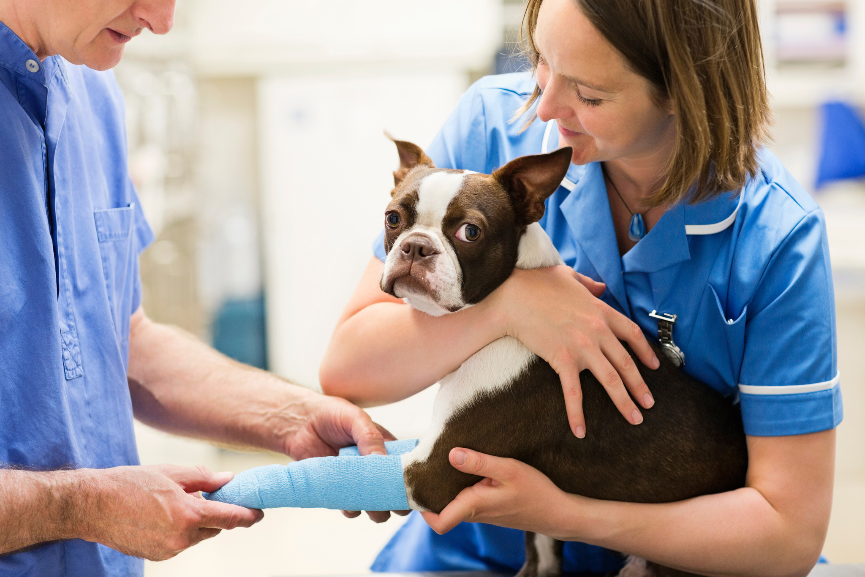
Technology
With advancements in technology and a growing emphasis on animal welfare, biotelemetric vital monitoring has witnessed significant growth and development in recent years.
Respiration is a fundamental process for all living organisms, including animals. Monitoring the respiratory flow in animals is crucial for getting important vital statistics as well as diagnosing and managing various respiratory conditions. Assessing an animal's respiratory rate, volume, effort and patterns gives valuable insights into their overall health and vital statistics and detect any potential respiratory issues at an early stage.
Traditional methods often involved invasive procedures or sensors into the animal's respiratory system. However, modern technologies now enable non-invasive monitoring, which reduces stress for the animals and provides more accurate results.
.
04

Slide 5

Technology
CURRENT CHALLENGES
SNORETTA SOLUTION
As a result of breeding, various respiratory diseases are most commonly caused by short muzzles in dogs.
A short muzzle compromises the normal functioning of the respiratory and thermoregulatory systems, and therefore exposes the animals to serious health problems. The condition is called brachycephalic obstructive airway syndrome (BOAS). With nearly 20,000 brachycephalic dogs in the United States alone.
We can interpret the breathing of dogs and other animals smoothly with the technology we have developed. We can see how the respiratory flow behaves during the exercise and therefore we can diagnose various respiratory diseases, such as kennel cough and sleep apnea.
05

Slide 6
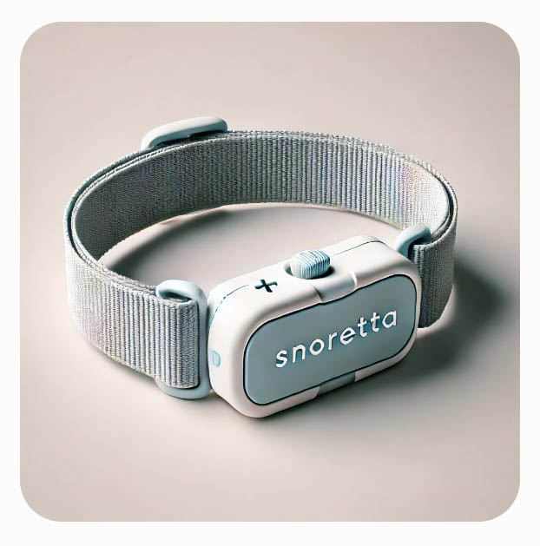
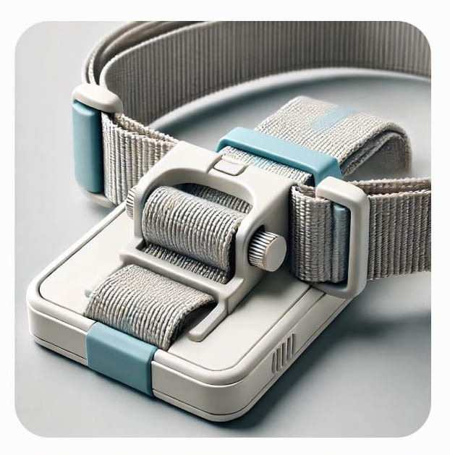
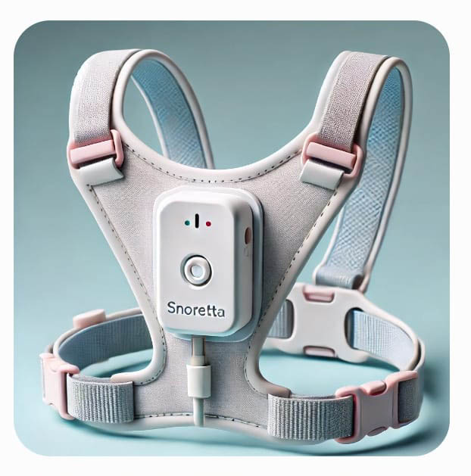

Solutions
09

Slide 7

Research
Biotelemetric monitoring in animal racing gives important real-time data also for monitoring vitals in animal sports. Looking ahead, this industry is expected to continue its growth trajectory.
Over the past two years our dedicated multi-professional research team has collaborated closely with the esteemed University of Helsinki's Faculty of Veterinary Medicine Research Department. This invaluable partnership has allowed us to gain deep insights into the physiological parameters and unique challenges associated with monitoring respiratory effort in animals.
Advancements in sensor technology, data analytics, and artificial intelligence are likely to drive further innovation in this field. These developments will lead to even more accurate and user-friendly monitoring devices, enabling better respiratory care for animals.
10

Slide 8
Markets
Respiratory flow monitoring devices for animals typically utilize innovative sensors and specialized software to measure and analyze various parameters
Snoretta devices can be tailored for different animal species, including small companion animals like dogs and cats, as well as larger animals like horses, livestock and camels.
They are designed to provide real-time data, allowing real-time monitoring of animal's respiratory health during routine check-ups, surgical procedures, animal sports events, or research studies.
The animal respiratory flow monitoring industry serves a wide range of stakeholders, including veterinary clinics, research institutions, pharmaceutical companies, racing courses and animal owners. Veterinary clinics benefit from these monitoring devices as they enable early detection and timely intervention for respiratory conditions, leading to improved treatment outcomes.
08

Slide 9
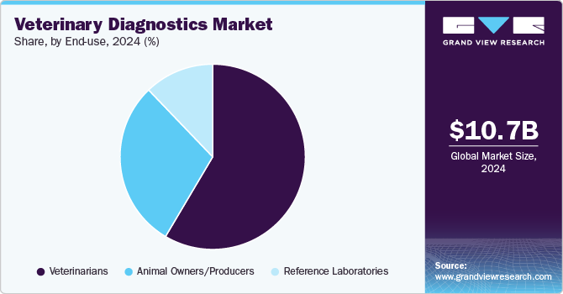
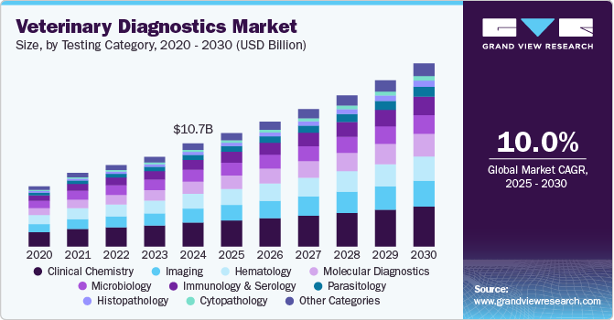
Markets
08

Slide 10



Investment Need
Partly, the new financing is needed to go-to-market i.e. creating the marketing and sales organisation.
Financing uses
Growth capability
Description
1
Background
So far, Snoretta has been a product development company, focusing solely on its revolutionary new solution. The Company requires new resources for the go-to-market process, intensified, parallel product development and setting up the support organisation
1
2
Marketing
and Sales
The amount of financing required for marketing depends on the future partnering strategy. Presently, Breathe is conducting several discussions with potential partners in various territories.
The Company needs to build various back-office functions, such as logistics, second level support for customers etc.
Go-to-market
Snoretta is looking for 500 000 € investment for Market entry.
3
Increasing headcount
The company will spend a part of the proceeds on increasing headcount and breaking into the other Nordic countries, followed by other EU countries and the USA
Additionally, new financing is needed for developing capabilities for growth
i.e. increasing the head count and breaking into the countries globally.
4
Process capability
In order to successfully implement the current and future new services.
processes for R&D, quality management, order and delivery management, customer care and operations are required
Aggressive global growth plan
5
Product and service
capability
Enabling growth and ensuring quality and profitability requires solutions that
are compliant according to GDPR as well as other regulations and standards
6
Execution capability
Enabling growth and ensuring quality and profitability requires solutions that
are compliant according to GDPR as well as other regulations and standards
The in-house personnel resources and competence are crucial for the realization of the growth program
10
08

Slide 11
Snoretta team
Mr. Mikko Rautiainen, Innovator and expert in the field of medtech. Mr. Rautiainen holds a M.Sc. in Tampere University of Technology, Faculty of Medicine and Health Technology. https://fi.linkedin.com/in/mikko-rautiainen-20a8a533a
Mr. Tuukka Visuri, Founder and tech innovator is a entrepreneur focusing on new and innovative health tech devices and applications, Mr. Visuri holds a M.Sc. in Information management and logistics from Tampere University of Technology, graduated 2003. LinkedIn
Mr. Usko Huuskonen, Clinical Neuropsychologist at Oulu University Hospital, Oulu University Hospital, Department of Pediatrics and Adolescence. LinkedIn
Mr. Mika Kallio, Docent in Clinical Neurophysiology
Mika Kallio is the Head of Clinical Neurophysiology department at Oulu University Hospital. During his 25 years of experience in clinical neurophysiology he has published extensively in the fields of central, peripheral and autonomic nervous system function and dysfunction. LinkedIn
Ms. Sari-Leena Himanen, Professor, Clinical Neurophysiologist
Sari-Leena Himanen is the professor of Physiology and Chief Physician of Department of Clinical Neurophysiology at Tampere University Hospital. Her research is focused on sleep-disordered breathing with a special focus on women and children.
M.s. Minna Rajamäki, Adjunct professor of small animal medicine, Title of Docent, Departments of Faculty of Veterinary Medicine Equine and Small Animal Medicine, Clinical Instructor, Equine and Small Animal Medicine Helsinki One Health (HOH), Supervisor for doctoral programme, Doctoral Programme in Clinical Veterinary Medicine
M.s. Iida Niinikoski, TBD
13

